Slide 1
Introduction
Cloud Computing Technology
&
Internet of Things

Slide 2
Definitions
Wikipedia
Cloud computing is Internet- (‛cloud-‛) based development and use of computer technology (‛computing‛). In concept, it is a paradigm shift whereby details are abstracted from the users who no longer need knowledge of, expertise in, or control over the technology infrastructure in the cloud that supports them. It typically involves the provision of dynamically scalable and often virtualized resources as a service over the Internet
Gartner
Cloud Computing: a style of computing where scalable and elastic IT-enabled capabilities are delivered as a service to external customers using Internet technologies
Forrester/Jupiter Research
A standardized IT capability (services, software, or infrastructure) delivered via Internet technologies in a pay-per-use, self-service way.

Slide 3
Definitions (contd)
A computing environment to elastically provide virtualized resources as a service over the Internet in a pay-as-you-go manner
  • elastically: enable to avoid under-utilization(idle servers) and overutilization(blue screen)
  • virtualized: enable to put whatever end user wants to use into the cloud, and access in anytime, anywhere, any devices
  • pay-as-you-go: enable a new ecosystem for end user, service provider, and vendors

Slide 4
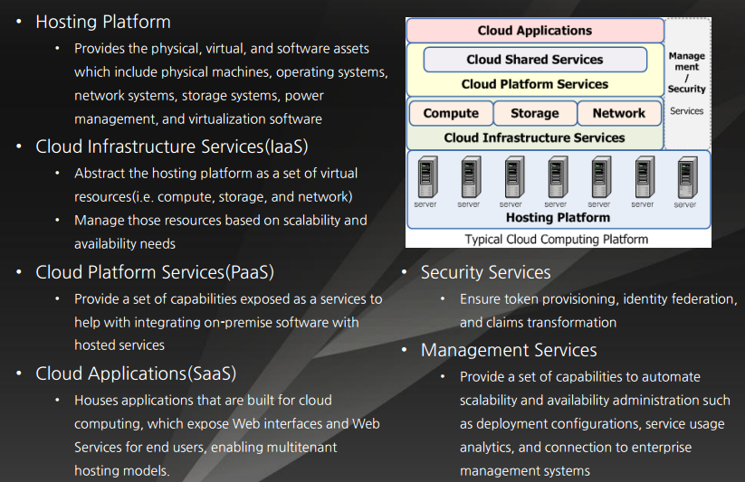
Typical Cloud Computing Platform

Slide 5
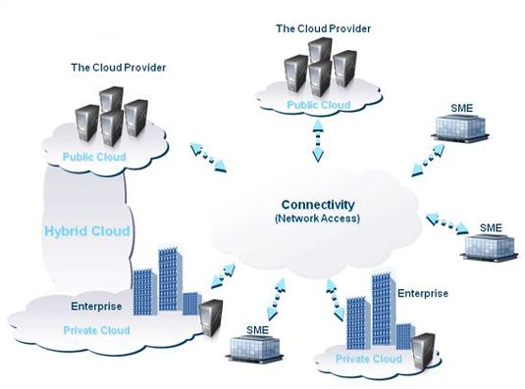
Type of Clouds

Slide 6
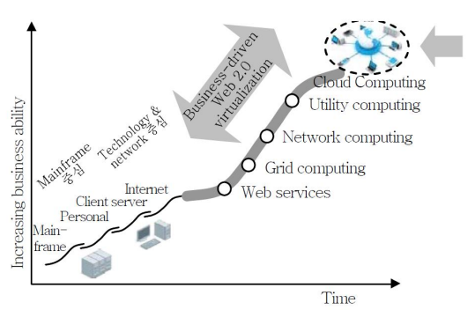
Cloud Computing is NOT a brand-new revolution

Slide 7
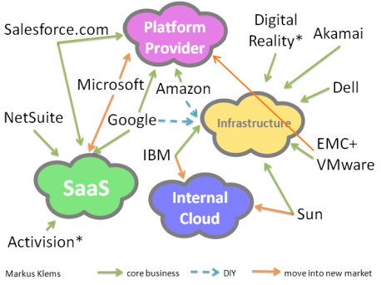
Cloud Wars

Slide 8
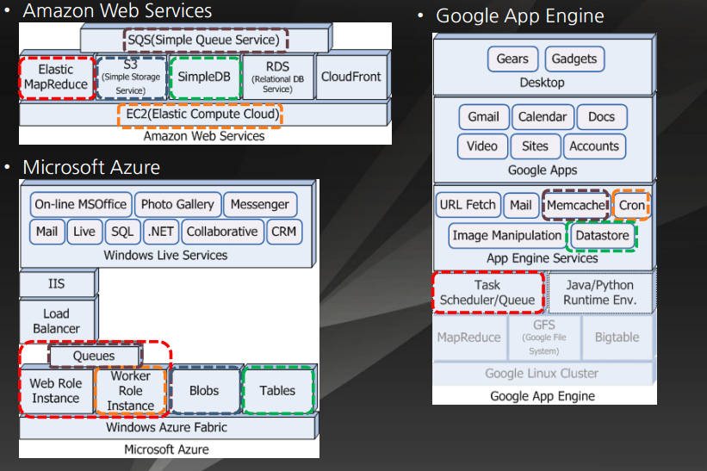
Architectures of Public Cloud

Slide 9
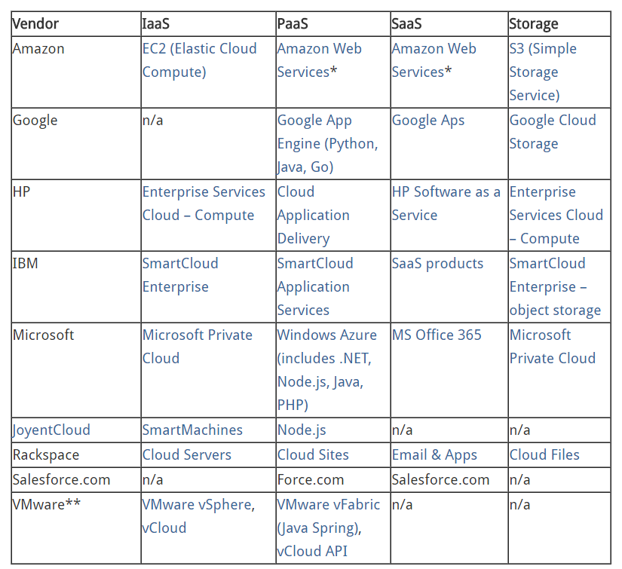
Major Cloud Vendors

Slide 10
Cloud Use Cases
File Storage, Synchronization & Sharing
Email
Blogging
Website Hosting
Disaster Recovery
Going Global
Test and Development
Short-Term Projects
Proof of Concepts
Seasonal Capacity
Business Intelligence/Big Data
Web, Social & Mobile
Advertising
CPU Intensive Applications
Financial Services/eCommerce

Slide 11
File Storage, Synchronization & Sharing
Everyone has heard of Dropbox, Box.net, Google Drive and even Bitcasa , right? These are file storage and synchronization services. Some provide limited storage while others are limitless. They scale (as typical clouds do) and they are on-demand and accessible via the Internet (more cloud characteristics). Many are consumer grade, however SMBs and corporations use enterprise-grade cloud storage which helps organizations centralize their data and files.

Slide 12
Email
This is the classic SaaS application which has been around for years. From Gmail to Outlook.com , consumers (and businesses) access this service via the Internet as well. Clearly an obvious and established use case, I felt compelled to include it despite its age.

Slide 13
Blogging
There are plenty of blogging platforms out there. To me, the hosted blogging service somewhat falls into the Platform play. However, when you move to self-hosted blogging platforms, you seem to move away from the multi-tenancy. That cleanly leads to the next use case…

Slide 14
Website Hosting
This is one of the most common business-oriented uses of cloud computing. While companies can host their web presences on physical servers or single cloud servers, the true scale and ability to grow comes when these business start enabling transactions or other web-based services within their hosted environments. If they are built in the cloud, they are prepared to scale and grow based on demand.

Slide 15
Disaster Recovery
Recently, this use case has become more prevalent for a number of reasons, I believe. For starters, setting up environments within the cloud has become much easier. Also 3rd parties are enabling redundancy and failover services as cloud computing matures. As opposed to traditional physical infrastructures which sit idle waiting to be “called into action,” cloud disaster recovery or failover environments can stand by as environments in “saved” states in the form of machine images, or they can be as hot standbys, meaning they contain live replicated files and data. We all know that hardware fails and people make coding mistakes, the cloud enables you to be ready to respond, even automagically!

Slide 16
Going Global
With traditional data centers, you typically select a physical location to best service your customers. But the web is global as is your audience. Many (not all) cloud providers are global with data centers around the world. This means that you can set up multiple presences to better localize your content, services or products. I know of companies overseas that are servicing a primarily US audience. So, while the HQ might be in Australia, their cloud presence is spread across the United States.

Slide 17
Test and Development
A couple of the niceties of the cloud is not only its immediacy but also how infrastructure or environments can be built up, tested and torn down quickly. Want to see how your application performs under load? Create a clone of it and load test it. Then “throw it away” when you are done with your testing. Wondering how an Ubuntu server environment performs compared to Windows Server? In minutes you can build up both and test side-by-side, then dispose of the one that you don’t want.

Slide 18
Short-Term Projects
Similar to test and dev, the cloud offers great tools for those short-term projects. Say you need a simple web presence or micro-site for a couple of months. You can easily stand one up in the cloud, use it during that period, then tear it down (and save it potentially for later use) when you are done. Also, projects that have a short runway can immediately find success in deploying cloud environments simply because you can be up and running in minutes/hours as opposed to days/weeks with traditional hardware requisitioning.

Slide 19
Proof of Concepts
Do you have an idea that you just want to try out? Perhaps you are a boot-strapped startup that wants to prove that your idea is a sound one to your potential investors. Instead of having to plunk down precious money as a capital expenditure, for significantly less, you can put your idea or concept in the cloud and see if you get the traction you are hoping for. If you follow the “build it and they will come” mantra, then cloud is for you. Just say no to that server in the back of your garage. There isn’t much reliability or performance with that route.

Slide 20
Seasonal Capacity
Scalability is, as I have said, one of the biggest advantages to using the cloud. If architected properly, you can set up a multi-tiered environment that has elasticity in the front-end (e.g., the web and application servers) while putting your larger database servers in a protected back-end. When you need capacity to meet the demands of your end users, you scale out that web/application server layer and when the need subsides, you scale it back. That way, you don’t leave any infrastructure under-utilized (that can get expensive).

Slide 21
Business Intelligence/Big Data
As more products and services are created and more users engage with these items, more information is gathered from and about them. Businesses are turning towards analytics, business intelligence and Big Data to find out more about their prospects and their customers. As the data grows, so must the environment that captures and analyzes it. Since the cloud is scalable, it’s a perfect partner for Big Data, analytics and BI. Often, the cloud is used as the presentation layer for the results of analysis.

Slide 22
Web, Social & Mobile
It seems like there is a new social service or aggregator of social content or mechanism to nurture communities being announced every week. And more often than not, these environments and services are being stood up in the cloud. If the service or offering succeeds, it can be scaled. If it fails, it can be easily shut down. All of this without much of a capital expenditure. As there is a convergence of web and mobile, meaning companies should always think about their mobile presence as more and more consumers use smartphones to access sites and services, the cloud overs a perfect platform for these multi-access environments.

Slide 23
Advertising
Advertising frequently is headless, that is to say, ads are dispersed yet centrally managed behind the scenes by a “mother ship.” It is becoming more frequent to have these advertising central servers to be hosted regionally in the cloud (and often, they are coupled with Contend Delivery Network – CDN – services). Used in conjunction with Big Data, advertising companies have become more agile by using the cloud as their primary compute and storage resource.

Slide 24
CPU Intensive Applications
One of the beauties of using the cloud is the immediate access to high performance compute consumed on a short term basis. Large quantities of data (think social media or health care or advertising) can be crunched using high-performance cloud environments. What traditionally would take weeks or more to requisition, stand up, configure and use, now can take days or even hours, especially if these cloud environments are saved for future use, and the resulting costs are a fraction of what traditional environments would be. This use case was one of the first to be showcased when cloud first started gaining traction.

Slide 25
Financial Services/eCommerce
Coupled with website hosting and Big Data is the eCommerce overlay. Companies want to make money and the best way to do this is to shopping-cart enable their product or service offering. And, as more and more businesses and consumers look to the web to manage their financial data (and that data continues to grow), the cloud offers that scalable benefit. While security is often cited as a concern, the cloud (depending on the vendor) is more secure than self-managed data centers and compliance concerns are being met head-on by architecting private cloud or hybrid cloud environments where user data (financial or personal) is heavily firewalled and secured away from a cloud front-end.

Slide 26
Key Differentiator
Many of the use cases described above can be used in conjunction with traditional hardware environments, but I would happen to guess that after seeing the capability of the cloud and the potential cost savings and flexibility, many older infrastructure installments might be phased out in favor of pure cloud architectures.

Slide 27
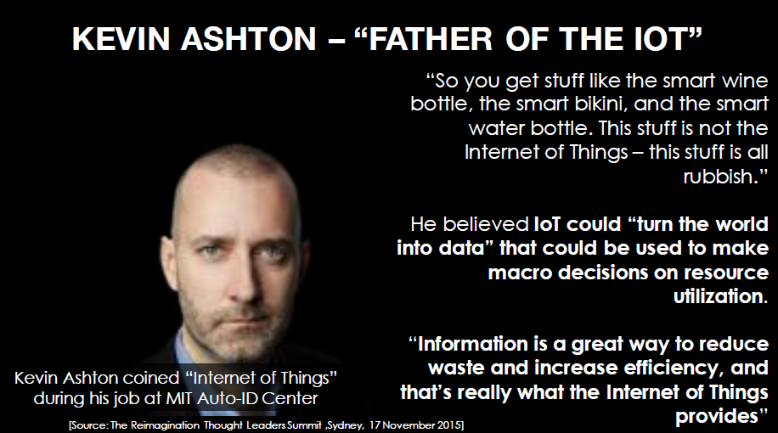
IoT (Internet of Things)

Slide 28
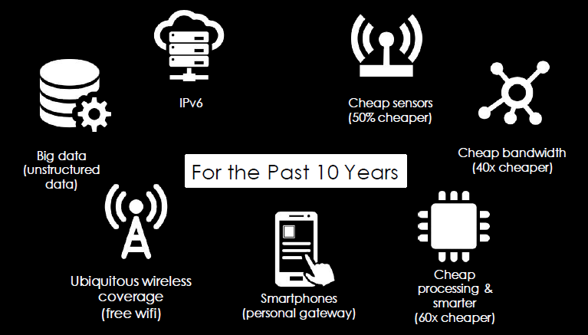
Technologies That Enable IoT

Slide 29
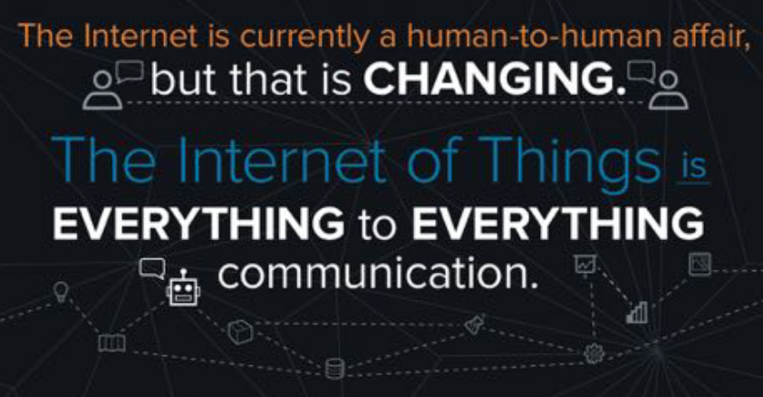
Everything to Everything

Slide 30
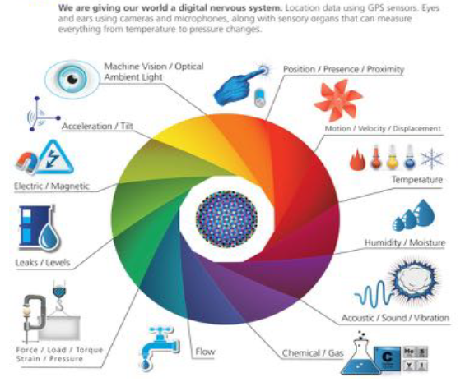
Sensors

Slide 31
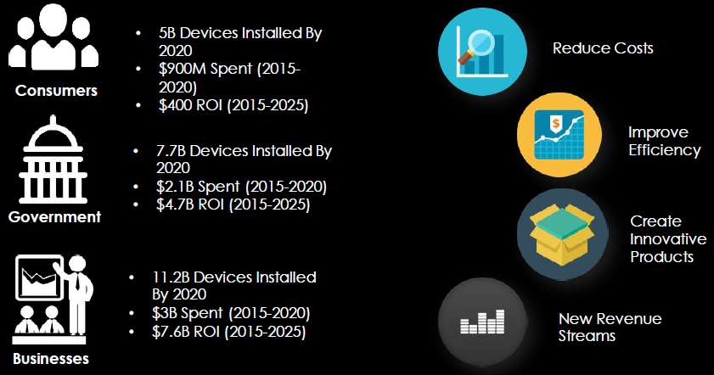
IoT Benefits

Slide 32
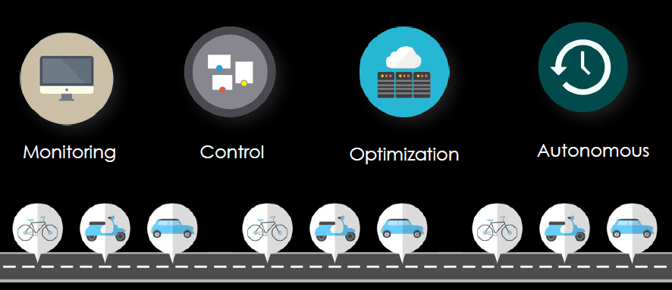
4 Stages of IoT Maturity

Slide 33
IoT Environments
Manufacturing
Transportation
Oil, Gas, and Mining
Insurance
Defense
Agriculture
Connected Home
Food Services
Utilities
Infrastructure
Retail
Hospitality

Slide 34
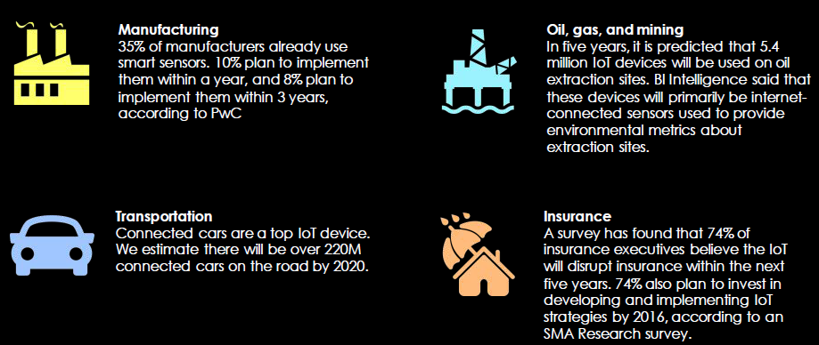
IoT Environments (contd…)

Slide 35
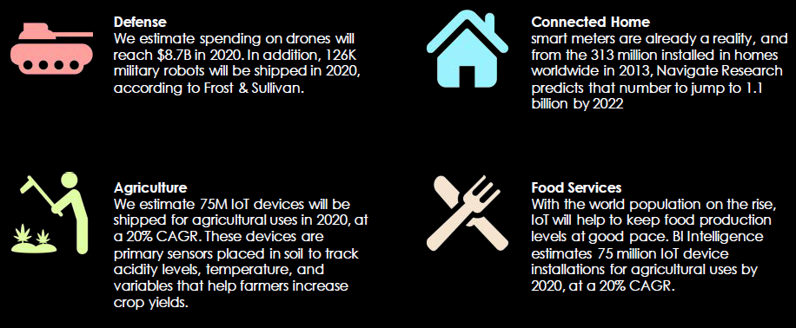
4 Stages of IoT Maturity

Slide 36
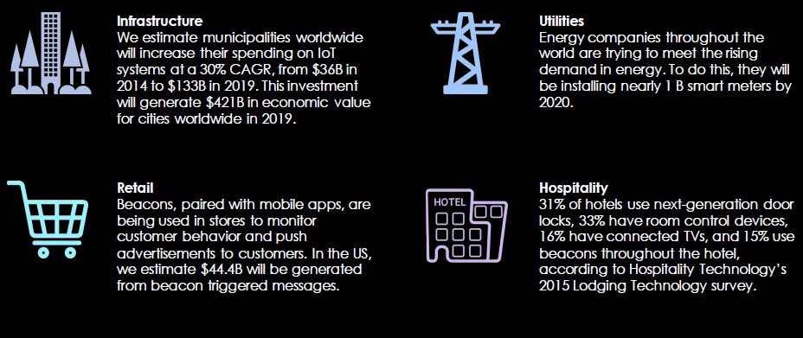
4 Stages of IoT Maturity

